Slide 1

Access Modifiers
TRAINING & RECRUITMENT
OFFSHORE DEVELOPMENT
IDENTITY MANAGEMENT
PORTAL DEVELOPMENT
APPLICATION DEVELOPMENT
5th Floor , V.V.Vintage-Boulevard, Somajiguda
Hyderabad – 500082 INDIA
Tel: 040-30605533

Slide 2
Topics
Static (Keyword)
Final (Keyword)
Packages
Access Modifiers

Slide 3
static
The static keyword in java is used for memory management mainly.
We can use static for variables, methods, blocks.
Static variables:
  If we created any variable with static we can directly access with class name we no need to create an object for the class.
  The static variable gets memory only once in the class area at the time of class loading.

Slide 4
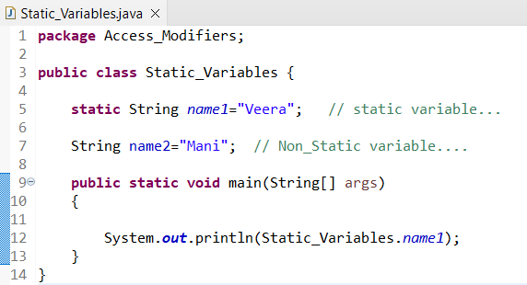
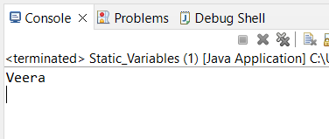
Example:
  Output:

Slide 5
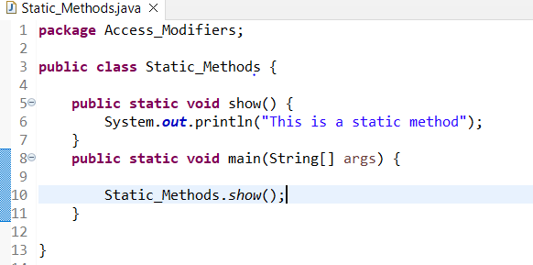
Static methods:
  Static methods belongs to class rather than object of class.
  Static methods invoked every time without creating instance of class.
  Static methods can accept only static variables and static methods only.
  Example:

Slide 6
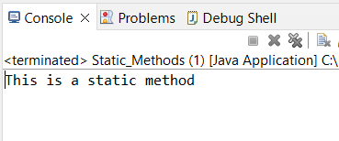
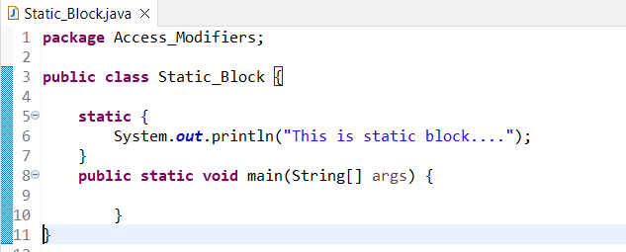
Output:
Static blocks:
It is executed before the main method at the time of class loading.
Example:

Slide 7
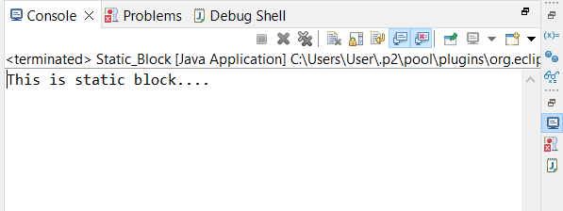
Output:

Slide 8
Final (Keyword)
The final keyword in java is used to restrict the use.
We can use final for ,
  Final variables.
  Final methods.
  Final classes.
Once we create anything with final we cannot modify or we cannot change.
Final Variable:
* once we declare a variable with final we cannot change or we cannot modify it.

Slide 9
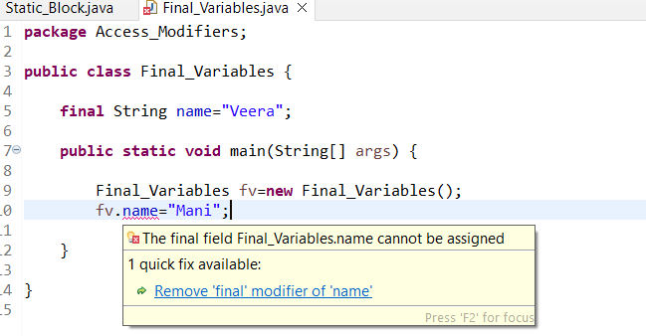
Example:
Final method:
If you make any method as final, you cannot override it in child classes.

Slide 10
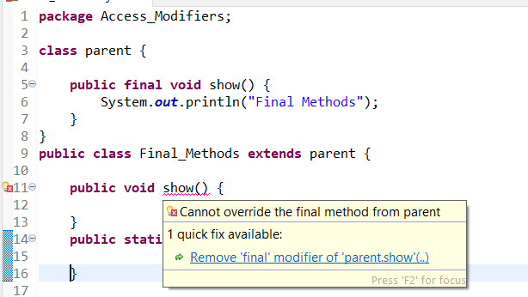
Example:
Final class:
If you make class as final we cannot extend in child classes.

Slide 11
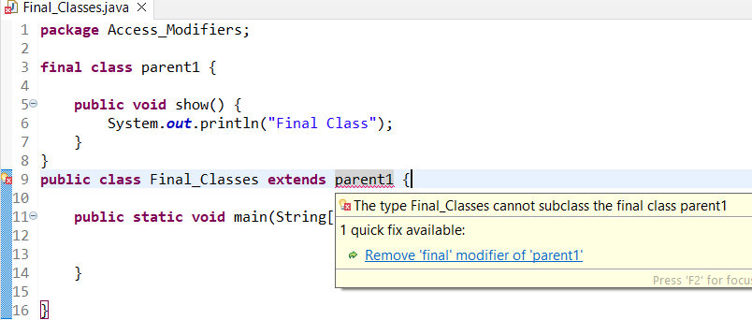
Example:
once we declare a class with final we cannot extend in subclasses

Slide 12
Packages
Packages is a group of similar classes.
There are two type of packages in java
  Pre-defined.
  User defined.
  Pre-defined (Build in packages):
  * this packages are pre defined in java we can use this classes by importing the require package.

Slide 13
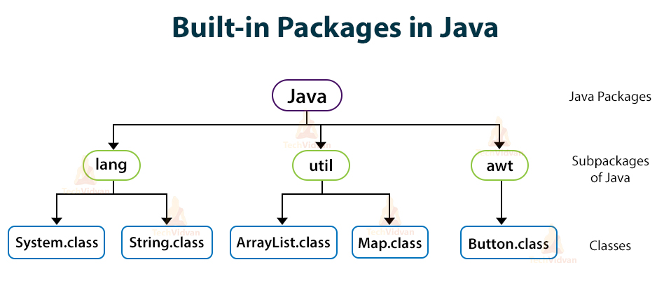
Example:

Slide 14
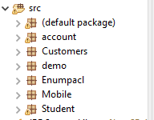
User defined :
* this is packages is created by the user based on the requirement and group a similar classes in a single unit.
Ex:

Slide 15
Access Modifiers
In java there are 4 type of access modifiers
  Public access modifier.
  Private access modifier.
  Protected access modifier.
  Default access modifier.
Public :
* We can use public for variables, methods and classes.
* once we create with public access modifier we can access any where in same project.

Slide 16
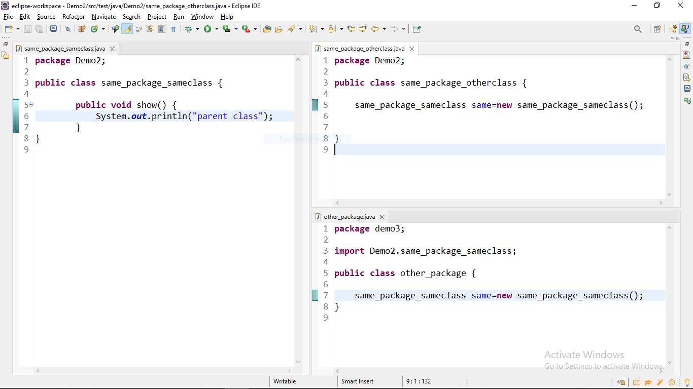
Example:

Slide 17
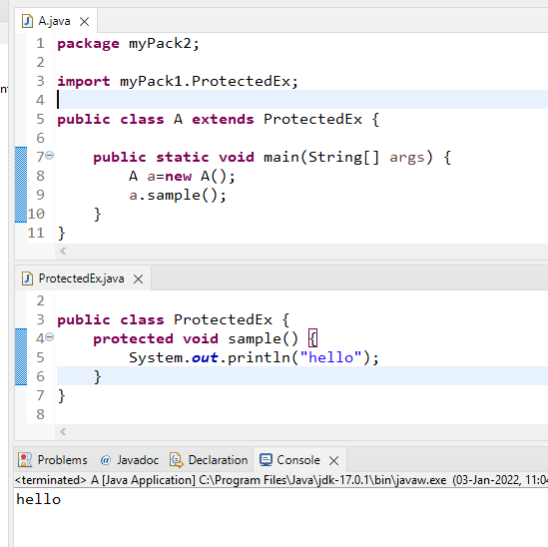
Protected:
* protected is use for variables and methods.
* if we declare any with protected we can access any where in same package and subclasses in other packages.
Example:

Slide 18
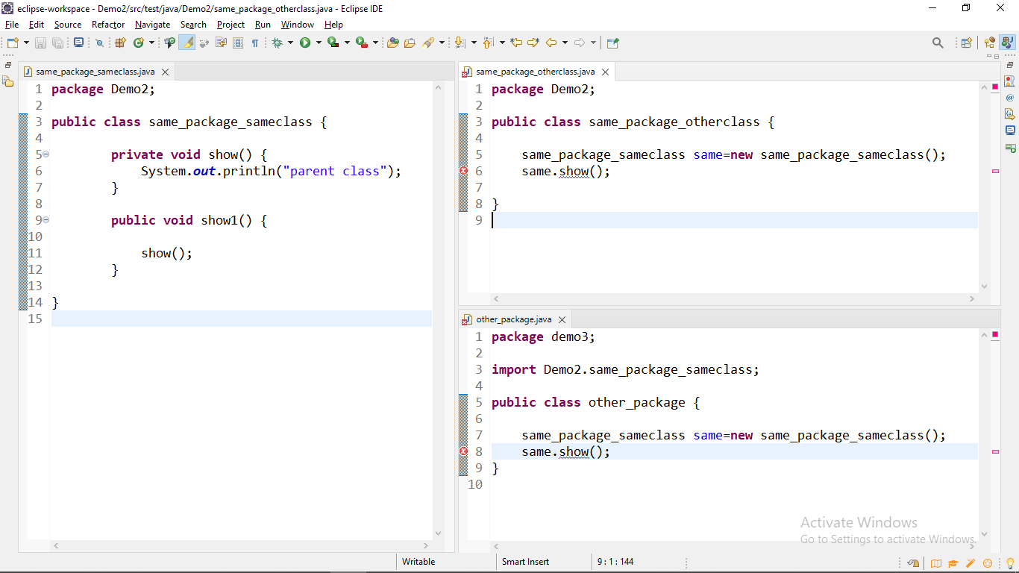
Private:
* we can use private for variables and methods.
* if we declare any with private we can access in same class only.
Example:

Slide 19
Default:
* default is use for variable, methods and classes.
* if we are not using any access modifiers like public ,protected, private by default it takes default access modifier we no need to mention explicitly.
* if we use default access modifier we access any where in same package we cannot access in other packages.

Slide 20
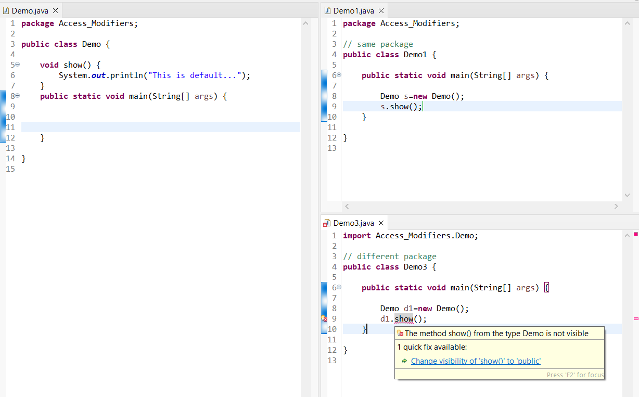
Example:

Slide 21
For further info please visit www.techstratinc.com
Thank You

